Slide 1
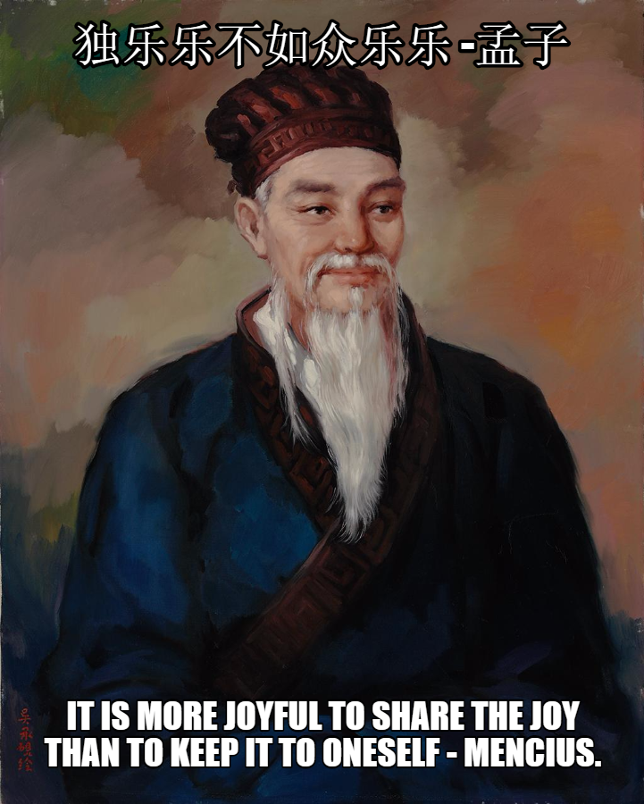
Happy Scientist Seminar Series #2
More on Collaborating with GitHub
Notes:
Welcome to the happy scientist seminar series second talk. The first talk went well enough that the series will continue to make researchers’ lives easier. This talk will be a little shorter because of examples shown at the end.

Slide 2
Creating a Repository
Repositories on GitHub website are created by someone administrative privileges. This creates an empty repository waiting to be used.
Once the repository is created the owner will be able to set all the permissions for it.
Anyone can create a local repository on their machine. This repository can then be cloned to GitHub.
Notes:
Currently the number of people who can set up a repository is limited but others can be added if needed. I recommend setting up the repository on the local machine first.

Slide 3
Setting up Your Repository
Create an admin team and a work team
(Optional) Create a local repository
Contact an administrator to create the repository on GitHub providing the repository name and the admin team that will have access
(Optional) Export the local repository to GitHub
Update and manage the repository
Notes:
Anyone can create a team. The new repository can be cloned to your local machine and the previously created local repository can just be copied into it. Example will be shown.

Slide 4

Working as a Team
One objective to working as a team is to
Or is it? Read the second word carefully.
Fortunately GitHub has tools to help make this a reality. There are also external tools such as LGTM.
Notes:
Mention people working on the same file and files being merged improperly. Being able to go back to previous commits helps alleviate this problem. Also mention accidental deletions of branches. This can be a more problematic. (Also mention the missing T)

Slide 5


Forks
or
Forks are copies of existing repositories. Any changes made to the copy do effect the original repository. Consider this like a fork in the road.
Notes:
Changes in forks can be merged back into the original by the creator of the original fork.

Slide 6
Branches
Every repository has a main branch. Consider this like the trunk of a tree.
Any branch from main (the trunk) will have a copy of the code at the time it branched from main.
A branch can also branch from a branch.
Unlike forks, branches are all in the same repository.
Notes:
Mention branches can have different permissions. People can be assigned to branches.

Slide 7

Merging
Now the problems begin.
Notes:
Mention people changing the same section of code.

Slide 8
Merging
Unlike trees, branches in Git can merge back into the trunk or other branches.
If the sections of code that changed in the branch didn’t change in the branch it is merging with there is no problem.
What happens if this is not the case?
That is where the tools come in.

Slide 9
Proper Merging
Limit who can do a merge (LGTM or GitHub)
Have someone look at the code and decide what the best way to merge them is
Test the merged code
Have the person(s) with merging privilege approve the merge
Notes:
Tools in GitHub to do this.

Slide 10
Examples
Creating a team
Creating a repository
Managing a team
Uploading an existing repository
Managing a repository

